Slide 1


Real-Time Human Pose Tracking CSC 699- Final Project Under The Guidance Dr. Chaoyang Zhang Presented by: Nandini Suridevara

Slide 2
Agenda
Introduction
Overview of MediaPipe Library
Implementation Workflow
Demonstration of Real-Time Tracking
Introduction to MPII Dataset
Validation and Evaluation Metrics
Results and Observations
Challenges and Limitations
Future Scope
Conclusion and References

Slide 3
Abstract
This project presents a real-time human pose tracking system using Mediapipe’s pose estimation framework. The system efficiently detects and tracks human body landmarks, enabling accurate pose recognition in dynamic environments. Validation against annotated datasets demonstrates the model’s precision through Mean Per Joint Position Error (MPJPE) analysis. The proposed approach offers a robust solution for applications in sports analysis, healthcare, and interactive systems.

Slide 4
Introduction
Human pose estimation is a crucial task in computer vision that involves detecting and tracking key body landmarks to understand human posture and movement.
Applications: fitness tracking, animation, sports analysis, AR/VR.
Objective: Real-time pose tracking using Media Pipe and validation via MPII dataset.

Slide 5
What is Human Pose Estimation?
Detects and tracks human joints (key points) like elbows, knees, etc.
Converts video frames into a skeletal model.
Two types:
2D pose estimation
3D pose estimation

Slide 6
Overview of Media Pipe Library
Open-source cross-platform ML framework by Google.
Pre-trained models for real-time pose tracking.
Pose module outputs 33 key points in 3D.
Works with CPU/GPU and supports Python/C++.

Slide 7
Media Pipe Pipeline
Input: Live video or images.
Detection of pose landmarks.
Post-processing and drawing.
Real-time performance: 30+ FPS on most devices.

Slide 8
Key Features of Media Pipe Pose
Lightweight and fast
Easy integration with OpenCV
Outputs coordinates, visibility, and connections
Suitable for edge devices

Slide 9
Implementation Steps
Initialize Webcam Capture
Covert frame to RGB
Process frame with media pipe pose
Draw pose landmarks

Slide 10
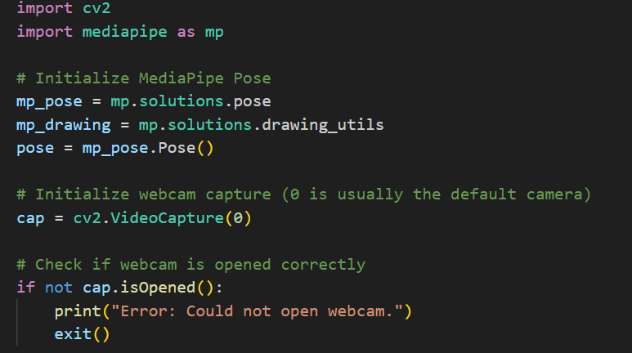
Sample Code Snippet

Slide 11
Introduction to MPII Dataset
Benchmark dataset for human pose estimation.
Contains ~25,000 images and 40,000 annotated poses.
Diverse activities and camera angles.
Used for accuracy evaluation and benchmarking.
MPII Dataset: http://human-pose.mpi-inf.mpg.de/

Slide 12
Validation using MPII Dataset
Load sample frames from MPII dataset.
Run MediaPipe on static images.
Compare detected keypoints with ground-truth annotations.
Evaluate using PCK (Percentage of Correct Keypoints) metric.

Slide 13
Results and Analysis
MediaPipe shows strong real-time performance.
High PCK scores on upper body joints.
Lower performance for occluded or twisted joints.
No training needed (pre-trained model).

Slide 14
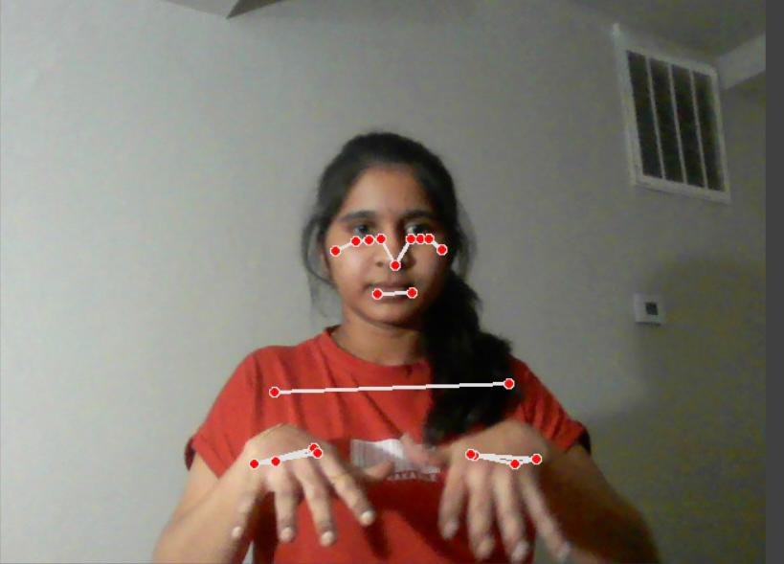
Pose Tracking Result

Slide 15
Validation Result

Slide 16
Challenges
Less accurate for extreme poses.
Noisy background or poor lighting can affect results.
MPII has some complex multi-person frames.

Slide 17
Future Work
Integrate MediaPipe with pose classification.
Fine-tune or combine with deep learning models.
Expand validation to include multi-person datasets like COCO.

Slide 18
Conclusion
MediaPipe is efficient for real-time human pose estimation.
MPII validation confirms robustness in general conditions.
Trade-off between speed and precision compared to heavy DL models.

Slide 19
References
MediaPipe Docs: https://google.github.io/mediapipe/
Cao, Zhe, et al. “Realtime Multi-Person 2D Pose Estimation Using Part Affinity Fields.” In Proceedings of the IEEE Conference on Computer Vision and Pattern Recognition (CVPR), 2017
Cao, Zhe, et al. “OpenPose: Realtime Multi-Person 2D Pose Estimation with a Single Deep Neural Network.” arXiv preprint arXiv:1812.08008, 2019.
Chu, Qi, et al. “Pose Estimation: A Survey of Methods, Applications, and Challenges.” IEEE Transactions on Image Processing, vol. 28, no. 4, 2019.

Slide 20

Thank You

